Slide 1


Determining Need for EI Services
Karen Kincaid, DS
Tiffany Madden, MA/CCC-SLP, Certified Fidelity Coach
Early Intervention Program Consultants

Slide 2




Presented in Collaboration with our Partners at:

Slide 3
Objectives
Participants will learn how to prepare for and perform a functional assessment.
Participants will learn how team members use information from multiple sources (medical records, evaluation, observation, parent report and other available information) to determine whether or not there is a need for services.
Participants will learn how to use assessment results to guide the IFSP process.

Slide 4

A word about
the 45 day
time frame…

Slide 5
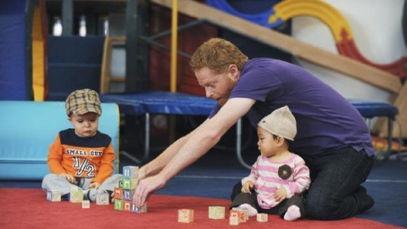
Eligibility

Slide 6
EARLY INTERVENTION REGULATIONS & RULES
3701-8-01 (Ohio Administrative Code)
  (B) "Assessment" as it applies to early intervention means the ongoing procedures used by qualified personnel to identify the child's unique strengths and needs and the early intervention services appropriate to meet those needs.

Slide 7
Early Intervention Regulations and Rules
Child Assessment
Mandatory
Assessment Procedures
(2) Family-directed assessment
Voluntary
3701-8-01 Definitions
(Ohio Administrative Code)

Slide 8
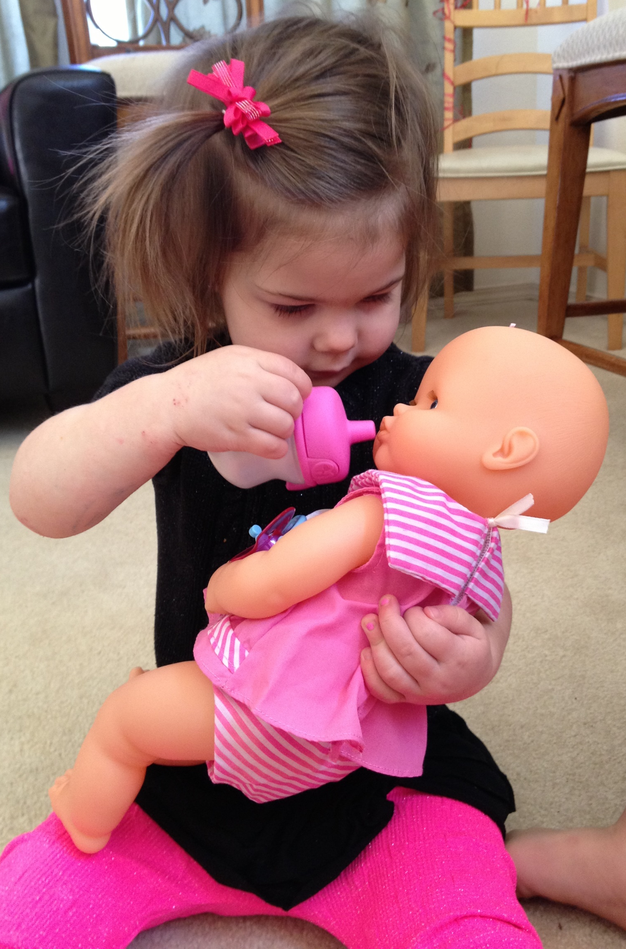
Checking all the Boxes: Zola, 22 months
Eligibility:
Scores on the Bayley Scales of Infant/Toddler Development III indicate a delay in expressive communication (scaled score= 4). Able to place pegs in pegboard, complete a simple puzzle, point to pictures in books. Sandy, Zola’s mother, reports that she uses 8 words.
Child Assessment/observations:
Zola showed the assessors her toys while jabbering. She was heard saying “dada,” “do” and “bye.” Zola enjoyed pretending with her baby doll and followed direction to “feed the baby.” Zola pointed to her brother when he was named and pointed to objects in the room.

Slide 9
Checking all the Boxes: Zola, 22 months
Record Review:
Zola received PE tubes at 11 months of age due to chronic ear infections. Followed by audiologist, hearing tested WNL.
Nutrition and Vision Status:
Screenings indicate no concerns.
Family Directed Assessment:
Sandy shared that Zola loves being rocked to sleep. She helps with dressing and undressing. Zola will eat “anything.” She plays well with others and also by herself. Her favorite toys are her baby doll and her blocks. Zola loves visiting. She only gets frustrated when she is not understood.

Slide 10

Purpose of Family Directed Assessment
Identify the strengths, needs, priorities of children and families with regards to early intervention
Determine family activities/routines on which to focus intervention (functional outcome development)
Measure a child’s engagement, independence and social relationships (McWilliam)

Slide 11
Purpose of Family Directed Assessment
Assess the “goodness of fit” between the child’s strengths/skills, family needs, and demands of the routine (McWilliam, 2010)
Establishing positive relationships with the family (McWilliam)

Slide 12
Questions Related to Everyday Activities and Routines
What activities do you and your child like to do
together?
What happens most
mornings? Afternoons?
Nights? Weekends?
What does your child enjoy and what holds your child’s attention?
What makes your child happy, laugh, smile?

Slide 13
Questions Related to Everyday Activities and Routines
What routines and/or
activities does your child not like? What makes these events uncomfortable or difficult?
Are there any activities
that you would like to do but currently are not able?
Who are the important
people in your child’s life? Who does your child spend the most time with and where?

Slide 14
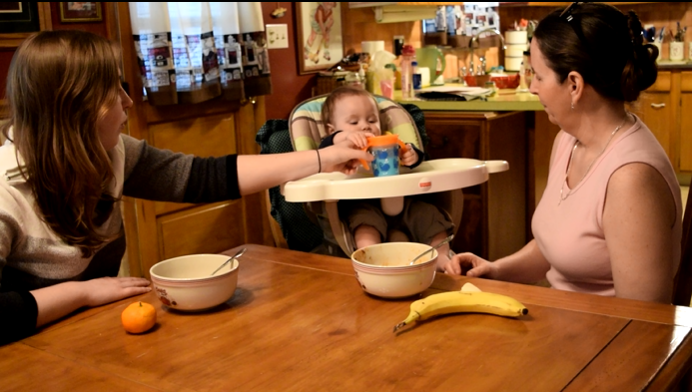
Questions Related to child participation
How does your child participate in (insert daily activity)?
How is your child interacting with others during this time?
How much does your child do for himself?

Slide 15
Poll question: Who conducts the family directed assessment on your team?
A. Service coordinators
B. One or both assessors from the multidisciplinary
team
C. Both service coordinators and assessors jointly

Slide 16
Poll question: Which statement best describes your assessment process?
A. The service coordinator shares information prior to IFSP development and it is used as assessment data for EI decision-making.
B. We are all so busy, each person plugs his or her pieces of assessment data onto the IFSP form prior to the meeting.

Slide 17
Poll question: When is the FDA typically conducted with families?
A. The same day as IFSP development
B. After evaluation and assessment, but prior to IFSP development
C. At the initial visit by the SC (before eligibility determined).

Slide 18

Authentic (Functional) Assessment in
Plain English:
Familiar people
In familiar settings
With familiar objects/materials
Doing familiar things
(Adapted from Pretti-Frontczak, et al., 2010 PPT presentation)

Slide 19
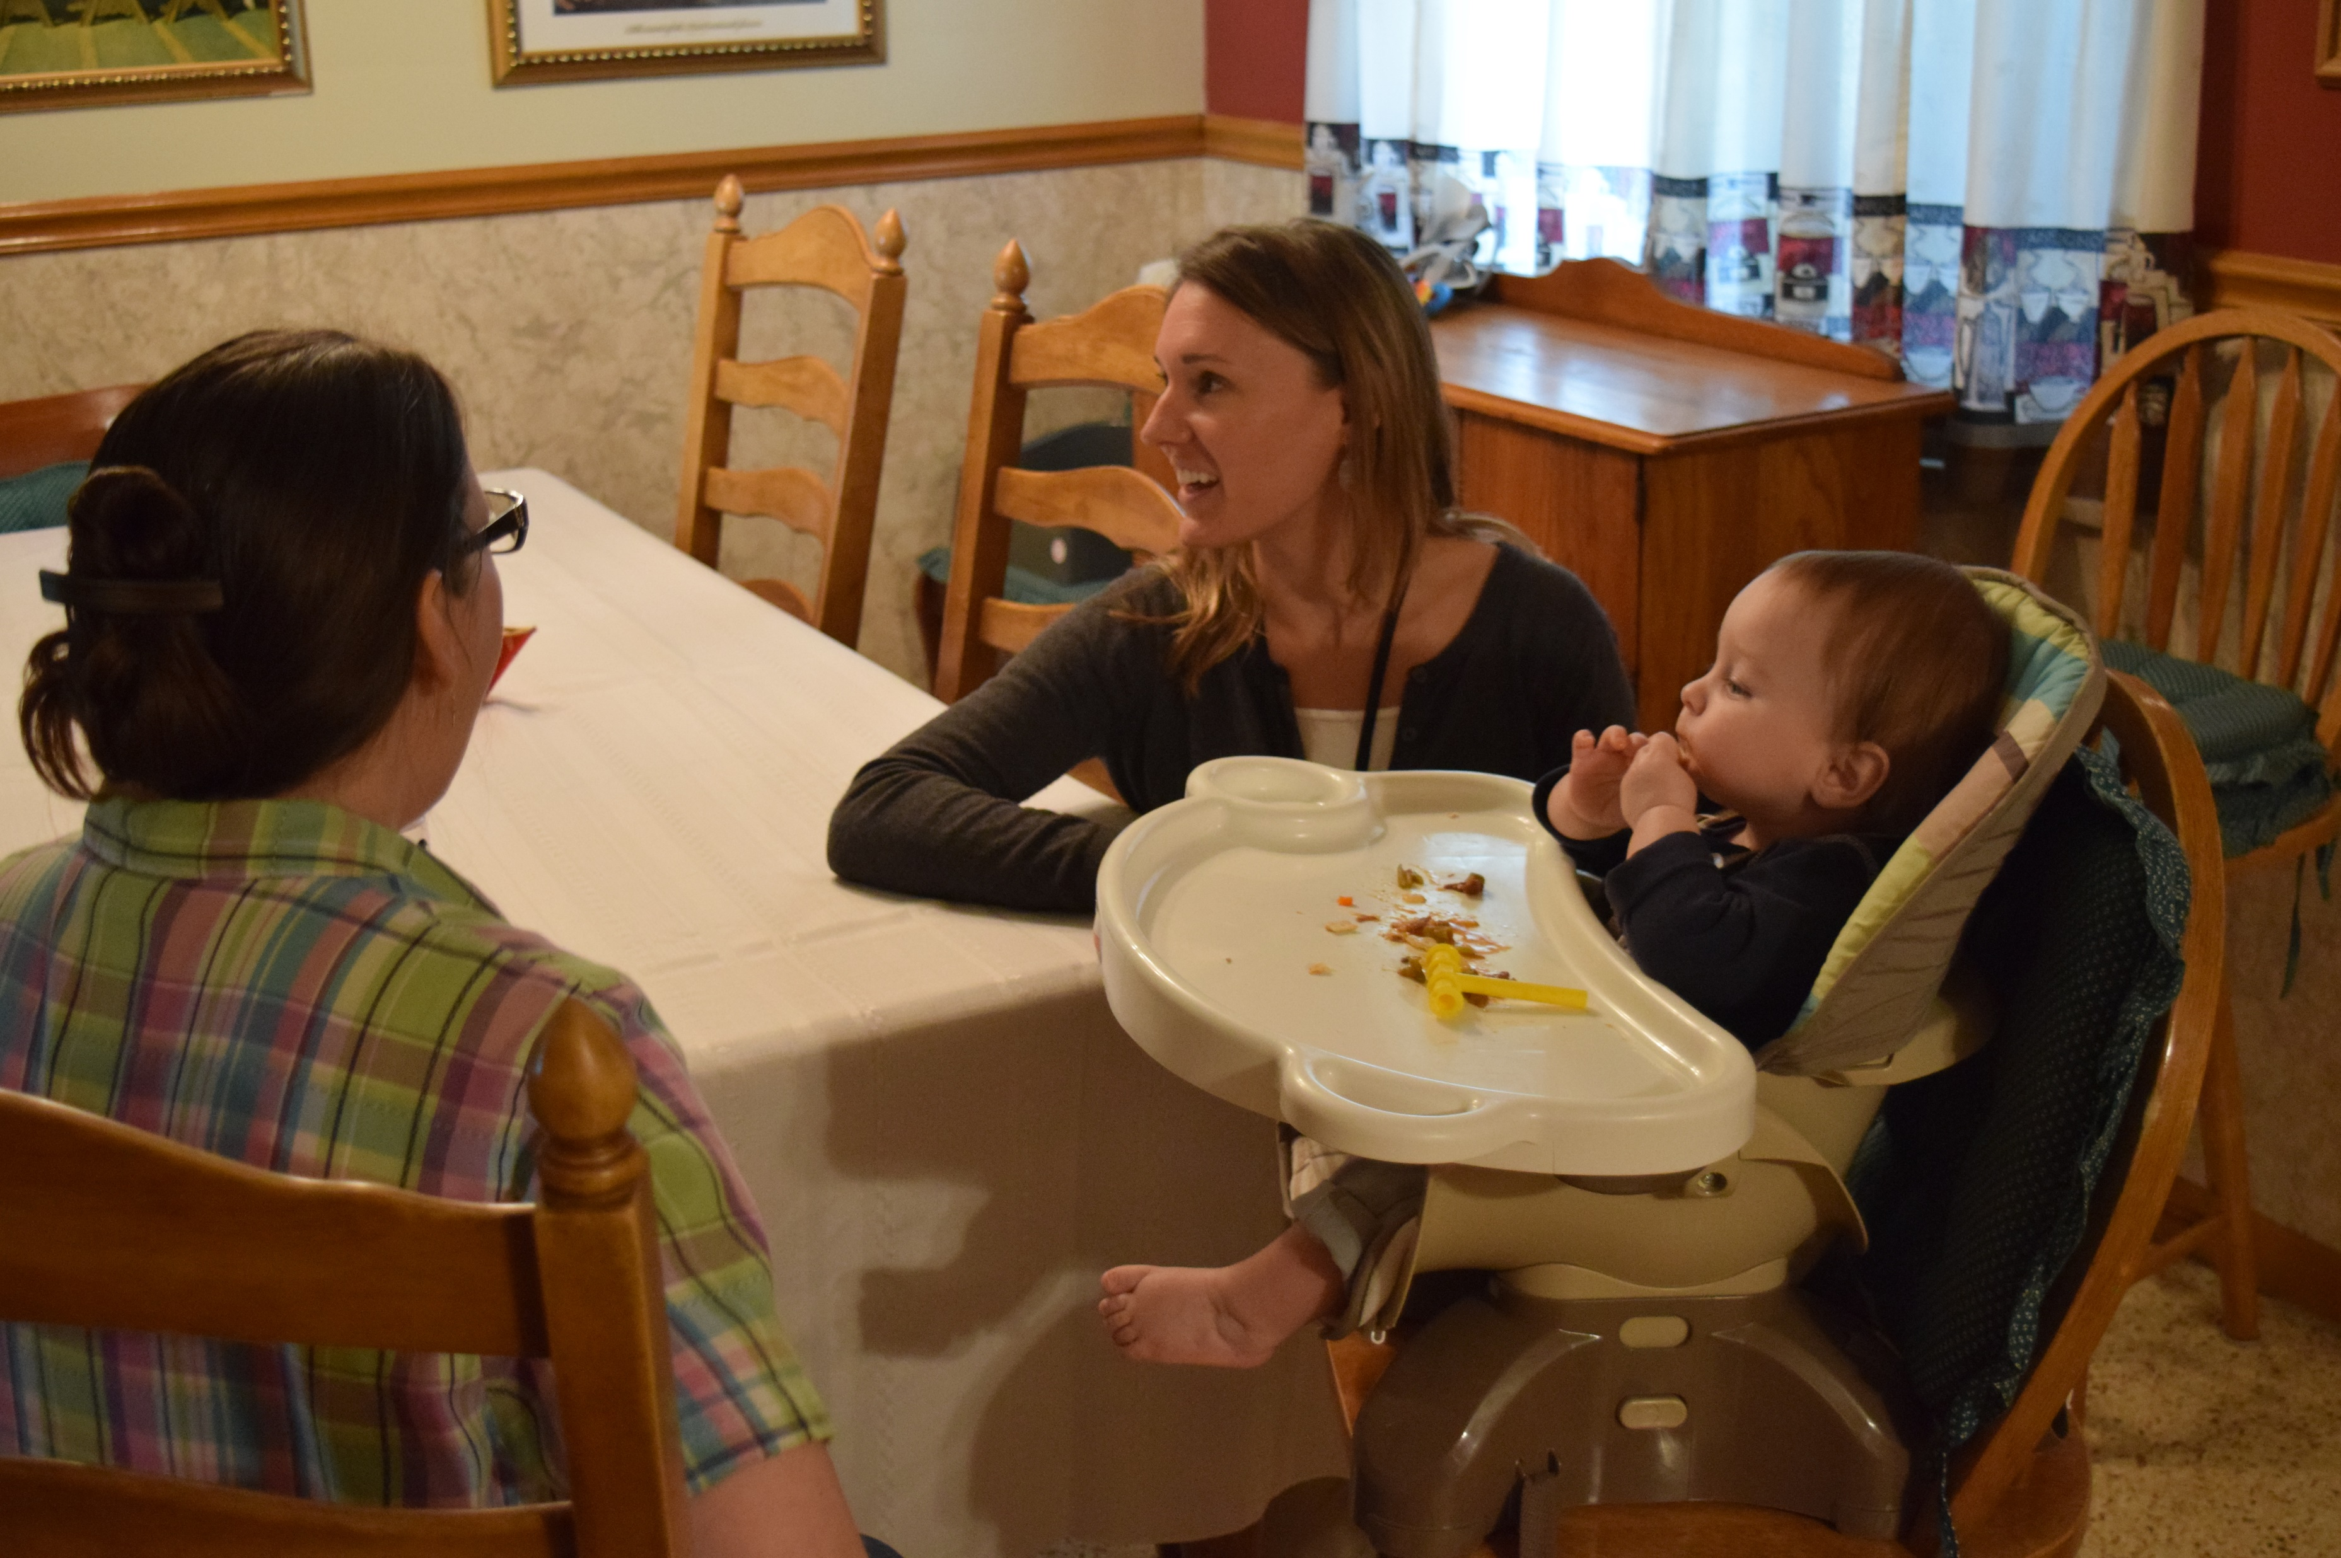
How is a Functional Assessment Performed?
K
Knowing the purpose for the assessment
Identifying the RIGHT assessment tool
Using ALL available information about the child and family from multiple sources
Hearing from others who know the child is critical
Involve
families!!
Involve
caregivers!
Source: http://ectacenter.org/knowledgepath/ifspoutcomes-iepgoals/ifspoutcomes-iepgoals.asp

Slide 20

Preparing for the Assessment:
Service Coordinator’s Role

Slide 21

Preparing for the Assessment:
Family’s role

Slide 22

Preparing for the Assessment:
Assessor’s role

Slide 23
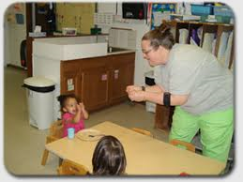

Performing The Assessment:
Assessor’s Role

Slide 24

Ideal Evaluation and Assessment Practices adapted from the FINESS IIa, R.A. McWilliam 2012
Looks Like | Doesn’t Look Like
Services are recommended based upon what is necessary in order for the child to meet IFSP outcomes and to successfully participate in typical activities and routines. | Services recommended are based upon a child’s delay or diagnosis.
IFSPs contain child and family focused outcomes. | Only child focused outcomes included on IFSPs.
Focus of assessment and intervention is on child’s functional use of skills in everyday routines and capacity building of families. | Focus of assessment/intervention is on child’s performance of skills listed on developmental tests or curricula.

Slide 25
Ideal Evaluation and Assessment Practices adapted from the FINESS IIa, R.A. McWilliam 2012
Looks Like | Doesn’t Look Like
Formal and informal methods are used to determine a child’s engagement, independence and social relationships in everyday routines. | Mostly testing results used for interventions.
All team members participate in entire evaluation/assessment process. Information is integrated for program planning. | Team members complete developmental evaluation and family directed assessment separately without sharing information.
Evaluations/Assessments include observation of a child within a natural environment. | Evaluation/Assessments do not include observation of the child within a natural environment.
Families are asked to rate their satisfaction with each routine. | Families are not asked about their satisfaction with everyday routines.

Slide 26
Poll questions
The assessment report for a child primarily lists what tasks the child completed on the Battelle.
A team of practitioners and the family jointly plan the specifics of the upcoming assessment including the location, routine of focus and questions to answer.
The family directed assessment describes the family’s daily schedule.
A family reports that their child is having difficulty feeding himself at daycare. A developmental specialist asks the family if it is okay for her to visit the daycare at lunch to help the caretaker brainstorm ways to make mealtime go more smoothly.

Slide 27
Functional Assessment IFSP Outcomes
Outcomes
Realistic picture using everyday settings
Functional and individualized
Recommends EI services and supports

Slide 28

Third Word Rule
The third word of IFSP child outcome statement should be a contextualized action that is functional.
Example: “Kim will eat with her family at mealtime eating the foods they eat.”
Shelden, M. L., & Rush, D. D. (2009). Tips and Techniques for Developing Participation-Based IFSP Outcome Statements. Briefcase, 2(1). Retrieved from http://www.fipp.org/Collateral/briefcase/briefcase_vol2_no1.pdf

Slide 29

The outcome is necessary and functional for the child’s and family’s life.
Criteria Defining
High Quality,
Participation-Based
IFSP Outcomes
The outcome is jargon-free, clear and simple.
The outcome
reflects real-life
contextualized
settings.
The outcome emphasizes the positive, not the negative.
The outcome crosses developmental domains and is discipline-free.
The outcome
uses active
words rather
than passive ones.
When the child’s contextual information is available, the following IFSP outcome criteria can also be evaluated:
The outcome is based on the family’s priorities and concerns.
The outcomes described both the child’s strengths and needs based on information from the initial evaluation and ongoing assessment.
ectacenter.org/~pdfs/pubs/rating-ifsp.pdf

Slide 30

Establishing Criteria
Answers the question: “What will
outcome achievement look like?”
Developed with family
If criteria embedded in
outcome, no need to include
in steps/activities

Slide 31

6-Step Criteria
Practice
Michael will accept
changes during playtime
and mealtime when in
the home and out in the
community.
The outcome statement is necessary and functional for the child’s and family’s life.
The statement reflects real-life contextualized settings (e.g., not test items).
The outcome crosses developmental domains and is discipline-free.
The outcome is jargon-free, clear and simple.
The outcome emphasizes the positive, not the negative.
The outcome uses active words rather than passive ones.

Slide 32

6-Step Criteria
Practice
Maddie will take
care of the chickens
by collecting their
eggs.
The outcome statement is necessary and functional for the child’s and family’s life.
The statement reflects real-life
contextualized settings (e.g., not
test items).
The outcome crosses developmental
domains and is discipline-free.
The outcome is jargon-free, clear
and simple.
The outcome emphasizes the
positive, not the negative.
The outcome uses active words
rather than passive ones.

Slide 33
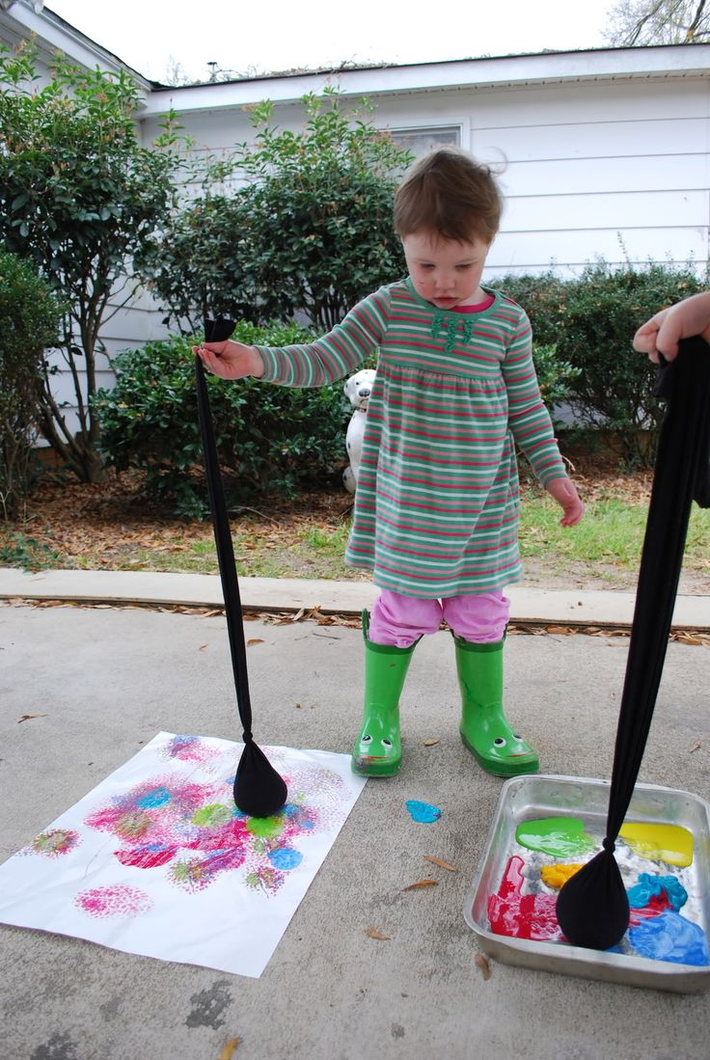
6-Step Criteria
Practice
Family would like
special instruction to
work on lessening gibberish
when Sami talks as well
as answering a question
when asked of her.
The outcome statement is necessary and functional for the child’s and family’s life.
The statement reflects real-life
contextualized settings (e.g., not
test items).
The outcome crosses developmental
domains and is discipline-free.
The outcome is jargon-free, clear
and simple.
The outcome emphasizes the
positive, not the negative.
The outcome uses active words
rather than passive ones.

Slide 34
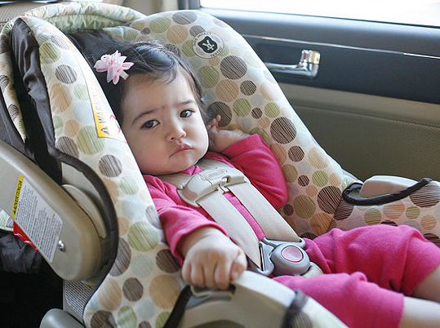
6-Step Criteria
Practice
Ava will look out of both
sides of the car to see the
holiday lights.
The outcome statement is
necessary and functional for the
child’s and family’s life.
The statement reflects real-life
contextualized settings (e.g., not
test items).
The outcome crosses developmental
domains and is discipline-free.
The outcome is jargon-free, clear
and simple.
The outcome emphasizes the
positive, not the negative.
The outcome uses active words
rather than passive ones.
The outcome statement is necessary and functional for the child’s and family’s life.
The statement reflects real-life contextualized settings (e.g. not test items)
The outcome crosses developmental domains and is discipline free.
The outcome is jargon-free, clear and simple.
The outcome emphasizes the positive, not the negative.
The outcome uses active words rather than passive ones.

Slide 35
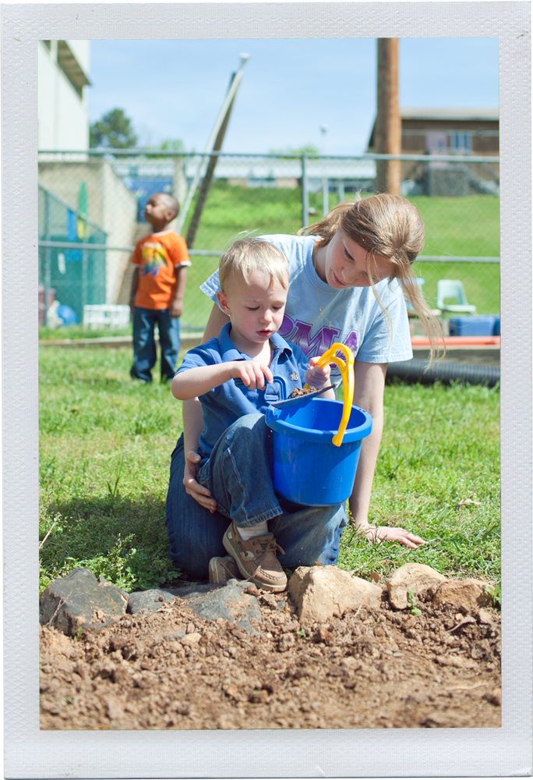
Steps/Activities to Meet
IFSP Outcomes
What will we do to accomplish the outcome?
Steps and activities specify who will do what in which everyday routines, activities and places.

Slide 36
Guiding Questions for Developing Steps/Activities
1. What resources and supports are already in place to help achieve this outcome?
2. Are there ways to help these existing supports be more effective in helping achieve the outcome?
3. What possible learning opportunities exist within current family routines or environments for helping meet the outcome?
4. What strategies will help achieve the outcome?

Slide 37
Additional Questions
5. Who else can help? What additional supports and services are needed to help achieve the outcome?
6. What are the appropriate roles for team members or others to play?
7. How will we know we are making progress, strategies are effective, or if modifications are needed?

Slide 38
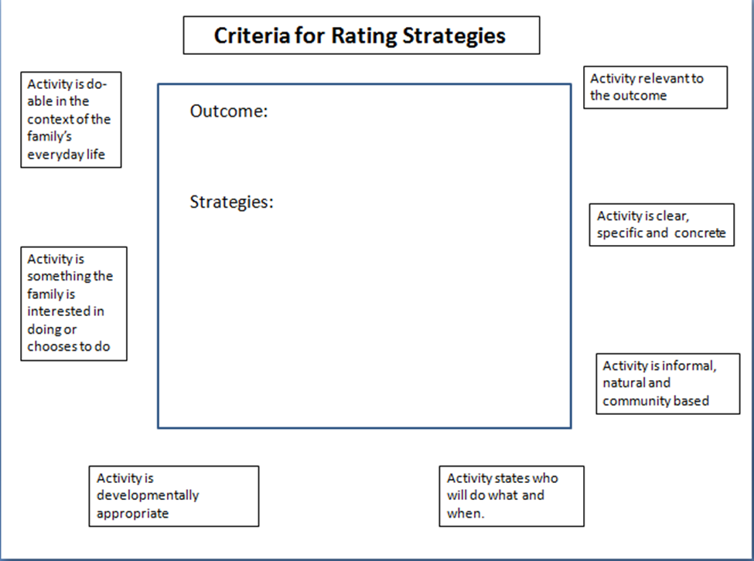
Developing Steps/Activities Practice: the 7-Step Criteria

Slide 39
Outcome: Maddie will take care of chickens by collecting their eggs.
Steps/Activities:
A. Family will encourage Maddie to practice squatting as they pick up laundry and toys.
B. PSP will coach Maddie’s parents on transitional movements.

Slide 40
Outcome: Ava will look out of both sides of the car to see the holiday lights.
Steps/Activities:
Ava will tolerate stretching exercises.
Mom will place Ava so that she has to turn to her left to watch the dog play and to interact with her when she is cooking.

Slide 41
Relationship of IFSP Outcomes to
EI Services
First…
develop IFSP outcomes based on functional, authentic assessment information
Then…
determine the EI services and supports based on what is necessary to meet the outcomes/goals

Slide 42
Services to Meet Outcomes
How often will the strategies likely need to be changed?
How often does the family/caregiver/teacher need support to be comfortable in using intervention strategies?
Jung, L. (2003). More is better: Maximizing natural learning opportunities. Young Exceptional Children, 6(3), 21-26.)

Slide 43


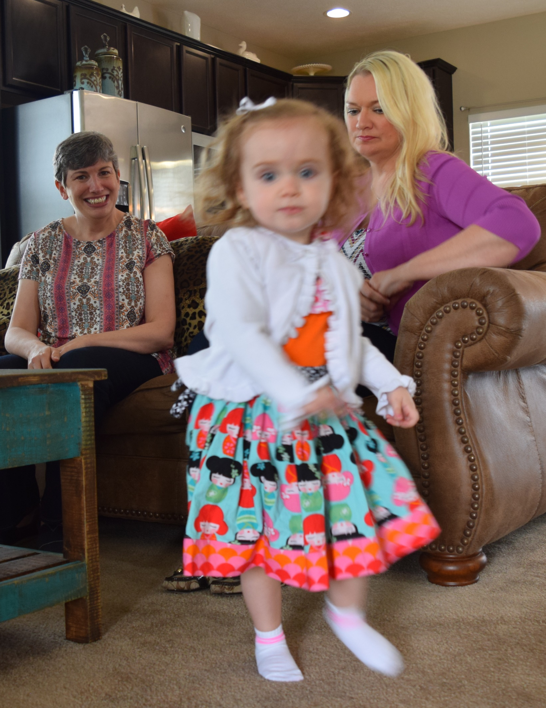
What is necessary to support a child’s caregivers in meeting an outcome? (McWilliam, 2010)
What intensity of this service is needed to address the outcome? (McWilliam, 2010)
What additional services are needed to help the primary service provider support the caregivers in carrying out interventions to meet outcomes (when using a trans-disciplinary approach) (McWilliam, 2010)

Slide 44


QUESTIONS

Slide 45
Resources
DEC Recommended Practices for Assessment
http://ectacenter.org/decrp/decrp.asp
Family Guided Routines Based Intervention (FGRBI)
and Caregiver Coaching
http://fgrbi.fsu.edu/
Virginia functional assessment handout
http://www.infantva.org/documents/Functional%20Assessment%20Nov%2014%20Desicion%20Tree.pdf
John Hopkins University School of Education: evaluation and assessment module
http://olms.cte.jhu.edu/olms2/135091
Results Matter Video
http://www2.cde.state.co.us/media/ResultsMatter/RMSeries/AuthenticAssessInEI_SA.asp

Slide 46
References
Kent State University Early Intervention in Natural Environments Community of Practice (n.d). Ohio Early Intervention Community of Practice. Retrieved from http://ohioeicommunityofpractice.weebly.com/
McWilliam, R.A. (2010) Assessing families’ needs with the routines-based interview. In R. A. McWilliam (Ed) Working with Families of Young Children With Special Needs (pp. 27-(43) New York: Guildford Press.
McWilliam, R. A. (Ed.) (2010) Routines-Based Early Intervention: Supporting Young Children and their families. Baltimore: Paul H. Brooks Publishing.
Pretti-Frontczak, K., Grisham-Brown, J., Hall, A., Rutland, J & Pfeiffer-Fiala, C (2010, November). Authentic assessment for planning intentional instruction in blended early childhood settings (PowerPoint Slides). Paper presented at the Division of Early Childhood Annual Conference for Young Children with Special Needs, Kansas City, Missouri.

Slide 47


Thank you!
Karen Kincaid Tiffany Madden
EI Program Consultant EI Program Consultant
Karen.Kincaid@dodd.ohio.gov Tiffany.Madden@dodd.ohio.gov

