Slide 1
Help Me Grow Central Intake & Referral Updates to EI Providers
February 24, 2022

Slide 2
AGENDA
Referral Data
EIDS Contact Notes
EI Communications Toolkit
Outreach campaigns & materials
Continuous Quality Improvement
Ohio State Fair

Slide 3
SFY21 EI DATA (July 2020 – June 2021)
39,213 system referrals

Slide 4
SFY20, 21, & 22 FIRST HALF EI DATA COMPARISON (July – December)
 | SFY20 (July-Dec 19) | SFY21 (July-Dec 20) | SFY22 (July-Dec 21)
System Referrals | 20,153 | 18,069 | 20,661
Program Referrals | 15,997 | 14,003 | 16,204

Slide 5
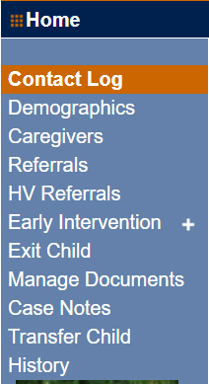
EIDS
20.4

Slide 6
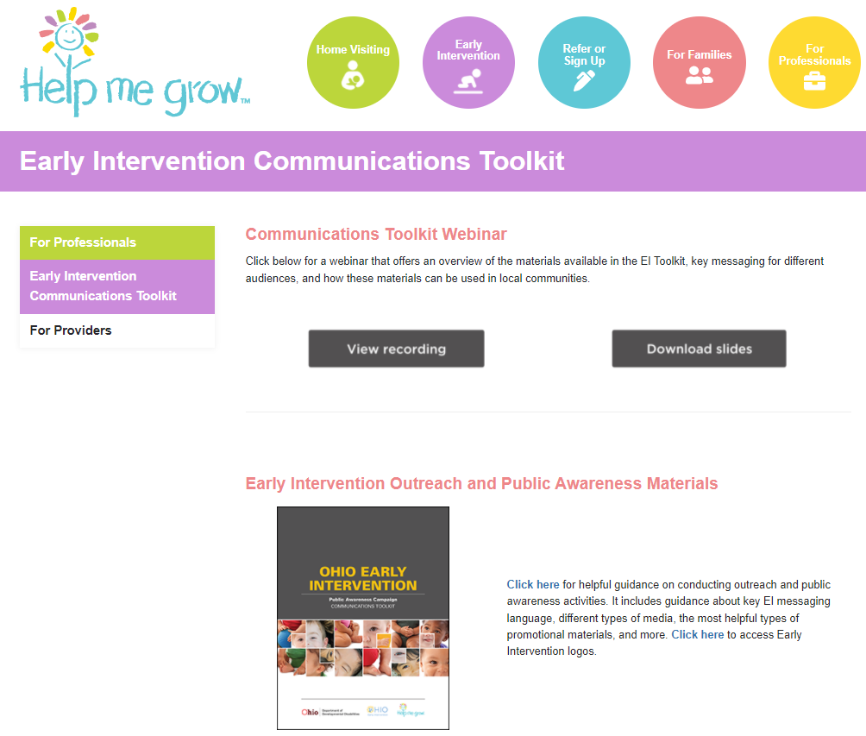
EI COMMUNICATIONS TOOLKIT

Slide 7
SFY21- 22 COMMUNITY ENGAGEMENT CAMPAIGNS
Don’t Wait, Act Early! targeting families and pediatricians
Elevated blood lead level (EBLL)
Neonatal abstinence/opioid withdrawal syndrome (NAS/NOWS)

Slide 8
DON’T WAIT. ACT EARLY! CAMPAIGN

Slide 9
EBLL CAMPAIGN
https://www.helpmegrow.org/EBLL.aspx

Slide 10
NAS/NOWS CAMPAIGN
https://www.helpmegrow.org/NASNOWS.aspx

Slide 11
SFY22 COMMUNITY ENGAGEMENT CAMPAIGNS
Specific delays
Targeting vulnerable populations
Child care
Online development screening

Slide 12
SPECIFIC DELAYS CAMPAIGN

Slide 13
TARGETING VULNERABLE POPULATIONS CAMPAIGN
Email marketing to referral sources
Parent and city magazine ads
Display and audio ads on public transit
Search engine optimization
Webinars/Online discussions

Slide 14
CHILD CARE CAMPAIGN
Training for child care professionals
Tip card on how to talk to families about EI included in packets of EI materials
Relationship building with child care centers
Attendance at professional associations
E-communications to child care providers

Slide 15
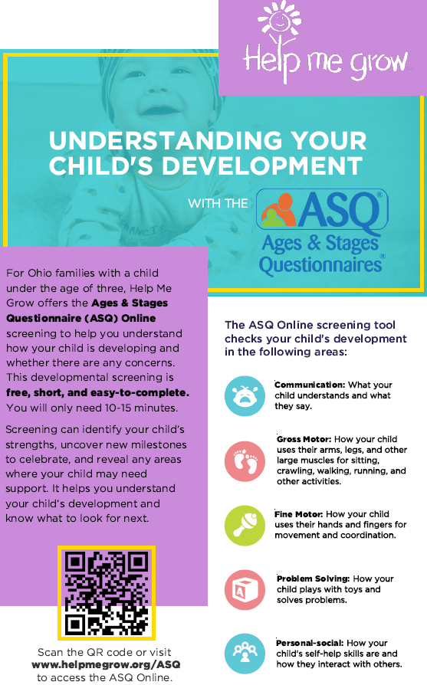
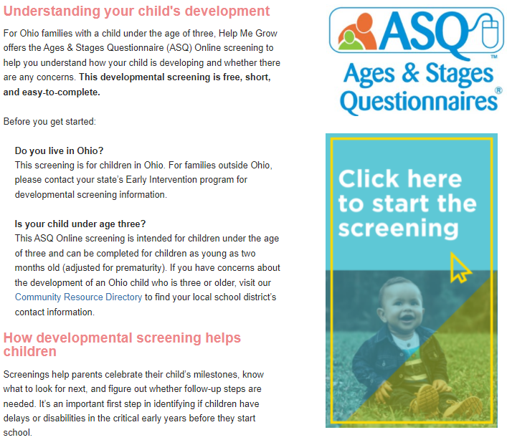
ONLINE DEVELOPMENTAL SCREENING CAMPAIGN
ASQ Online Services card/flyer with QR code
Social media
Search engine optimization
Radio
Texts/Emails to previously referred families (declined/ found not eligible)

Slide 16
ADDITIONAL MATERIAL
EI Brochure
EI Developmental Wheel

Slide 17
ADDITIONAL MATERIAL
Privacy Cover
Cell Phone Stand
Notepad
First Aid Kit

Slide 18
EI MATERIAL USAGE

Slide 19
SUCCESSFUL OUTREACH STRATEGIES
Share your successful outreach strategies in the chat box

Slide 20
CONTINUOUS QUALITY IMPROVEMENT
PCSA referrals - 10% increase in PCSA system referrals and improved conversion rates for manual referrals in specific counties
Child Care referrals - 10% increase in child care system referrals across Ohio
Caregiver referrals - 5% increase in caregiver system referrals across Ohio

Slide 21
OHIO STATE FAIR
Story time with guest speakers
Early literacy activity
Selfie station
Chill zone
Referral station
Imagination Library station

Slide 22
CLOSING
Questions/Comments:
Email communications@helpmegrow.org

