Slide 1
Working Together to Improve Outcomes for Families
Help Me Grow Overview for Public Children Service Agencies
March 10, 2021
Notes:
Janene

Slide 2
Agenda
Welcome and Purpose
Updates to Form
Help Me Grow System of Supports
Bright Beginnings – Central Intake and Referral
Ohio Department of Health – Home Visiting
Ohio Department of Developmental Disabilities – Early Intervention
Plan of Safe Care Collaboration
Making a Referral
Notes:
(history (sept. 2012), high-level changes, why we made the changes, referral options (agencies came together to make sure language matched what PSCA experience) – Liz

Slide 3
Purpose
Share changes to the HEA 8021 Form used by child welfare staff to facilitate referrals to Help Me Grow
Provide an overview of the Help Me Grow System, including Resource and Referral, Early Intervention and Home Visiting
Provide an overview of the Plan of Safe Care
Facilitate collaborative relationships between local child welfare agencies and Help Me Grow Early Intervention and Home Visiting programs
Share changes made to SACWIS to support the implementation of the revised HEA 8021
Notes:
Janene

Slide 4
Introducing the HEA 8021
First introduced in July 2011 to create a streamlined way for families with children under 3 years of age to be referred to Help Me Grow from Children’s Services
Intention of the form is to connect families to the following services:
Early Intervention – to work with children with a diagnosed dely or concerns of a delay
Home Visiting – to provide support to families, including parent education and connections to community resources
Changes include streamlining information, removing unnecessary required fields, updating language to reflect current practice, rearranging information to allow for better flow
Notes:
Liz

Slide 5
OVERVIEW OF UPDATES
Added PCSA county information
Designates the Caseworker’s role which allows the Service Coordinator and/or Home Visitor to know the current status of the family’s involvement with the PCSA
Removed the referrer’s signature line to allow for easier submission of the electronic form.
Notes:
Liz

Slide 6
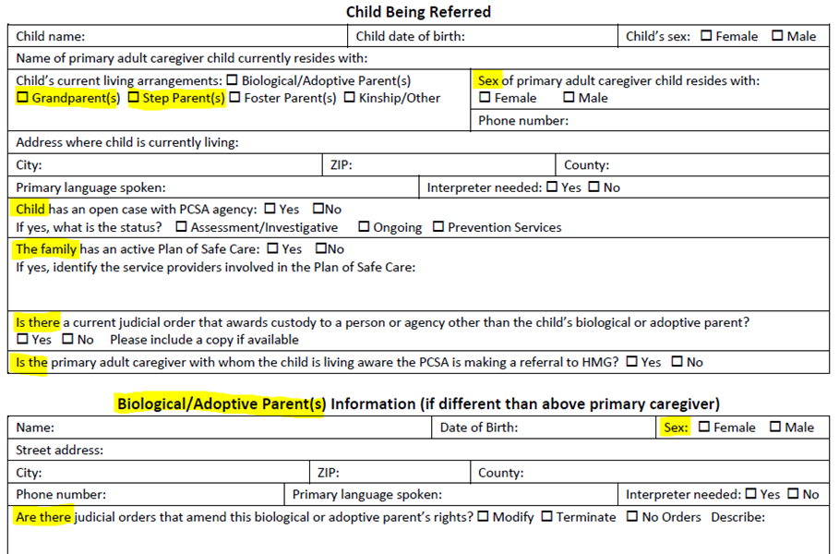
OVERVIEW OF
UPDATES
Created separate areas for current primary caregiver and biological/adoptive parents (if applicable)
Included grandparent(s) and step parent(s) as options for child’s current living arrangement
Added sex of primary caregiver and biological/adoptive parent
Updated information regarding open case plan and status and moved to child section
Added question regarding Care of Safe Plan
Included question regarding caregiver’s awareness of referral
Updated judicial order information and moved to parent section of form
Notes:
Liz

Slide 7
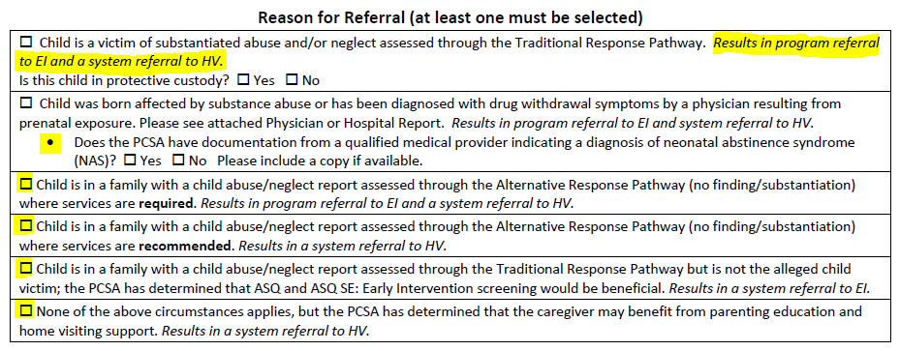
OVERVIEW OF UPDATES
Referral reasons expanded and clarified to support the caseworker choosing the most appropriate option based on the description of the family’s involvement with Children’s Services
Notes:
This section saw the most updates on the form. We wanted to make sure that the language used on the form matched language currently used in the field to describe a family’s involvemen with Children’s Services. We wanted to describe the various scenarios that caseworkers would encounter that would lead to Help Me Grow referrals.

Slide 8
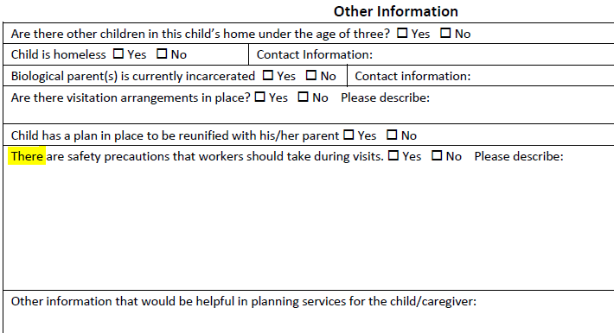
OVERVIEW OF UPDATES
Added information regarding safety precautions that should be taken during family visits
Requests added throughout the form to include documents such as judicial orders and physical/hospital reports when making a referral
The form must be completed it its entirety – all information is required to be entered into the OCHIDS data system for Help Me Grow.
Central Intake and Referral will not be able to complete the referral communication without all fields completed on the form.
Notes:
Liz

Slide 9
Help Me Grow is Ohio's system of supports for pregnant women, caregivers with new babies, and families with young children with developmental delays and disabilities.
Notes:
Nikki and Melissa

Slide 10
CENTRAL INTAKE AND REFERRAL Presented by Bright Beginnings
Notes:
Good morning, everyone. I am Nikki Montgomery, Senior Community Liaison at Bright Beginnings. With me is Melissa Bixel, Contract Manager for the Statewide Central Intake and Referral System.
Thank you for giving us the opportunity to share information about the Early Childhood Central Intake and Referral model currently provided by Bright Beginnings for Early Intervention and Home Visiting across Ohio. At Bright Beginnings, we are passionate about getting families connected to services that support a healthy life.
Bright Beginnings was awarded the statewide contract through the Ohio Department of Health in July 2018. Since that time, we have developed a system that is flexible to meet the needs of the state departments, service providers, and families.

Slide 11
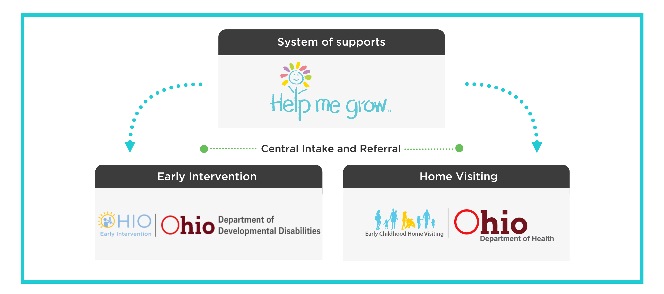
THE HELP ME GROW SYSTEM OF SUPPORTS
Notes:
Services and supports from Help Me Grow are provided through two programs - Home Visiting and Early Intervention – which you will hear more about today.
Home Visiting is a voluntary, home-based service offered at no cost to the family. Trained professionals offer information and support during pregnancy and empower parents of young children with the skills, tools, and confidence to nurture the healthy growth of their child throughout the child’s earliest years.
Early Intervention Early Intervention (EI) works with families with children birth to age 3 who have developmental delays or disabilities so that they have the best possible start in life.
As the statewide contractor for Central Intake for both Home Visiting and Early Intervention, Bright Beginnings has the role of reaching out to families, referral sources and providers to increase quality referrals and connect families to the services and supports they need to thrive.

Slide 12
ABOUT CENTRAL INTAKE & REFERRAL
POINT OF ENTRY
DATA-DRIVEN
COLLABORATIVE
COMMUNICATION
Statewide single point of entry, where every door is the right door to access needed services
Standard procedures, quality assurance, controls, professional development, and reports
Regional centers operate in partnership with other entities across Ohio
Marketing, communications and outreach
Notes:
I want to start by talking about what Help Me Grow Central Intake is and how it is helpful to families, referral sources, and providers.
CIR is a single point of entry where every door is the right door to access services. Families or professionals can submit referrals through Central Intake, and our staff will connect them with programs that can meet their needs.
Referral sources do not have to keep up with the different eligibilities for programs or where to send a referral for a particular county. An easy way to think about who should be referred is that if it’s Prenatal to Three – Refer!
The bottom line is that families get connected to services that best meet their needs and preferences….and that also avoids duplication in services.
Help Me Grow Central Intake also promotes the importance of the prenatal to three years with consistent messaging throughout Ohio, builds partnerships with referral sources, providers, and community stakeholders, and uses data-driven practices.

Slide 13
WHO SHOULD BE REFERRED TO HELP ME GROW?
Every child age 0-3:
With a substantiated abuse/neglect (CAPTA) case
Affected by substance abuse or diagnosed with drug withdrawal symptoms
Suspected developmental delays or disabilities
With a family that could use parenting support and is interested in services
As well as:
Children placed with relative/kinship caregivers
Children in the reunification process, beginning overnight visits
Children within a family assessed through the Alternative Response Pathway or Traditional Response Pathway even if they are not the alleged child victim
Pregnant women involved in the Alternative Response Pathway or Traditional Response Pathway
Pregnant teens in custody
NOTE: Foster parents are not eligible to receive home visiting services but children in foster homes can receive Early Intervention services.
Notes:
Which children should be referred to Help Me Grow?
Every child with substantiated abuse/neglect (CAPTA)
Every child affected by substance abuse or diagnosed with neonatal abstinence syndrome or drug withdrawal symptoms
Every child who has suspected developmental delays or disabilities
Every child who could benefit from their parents having one to one parenting support and education
In addition to this group of children, other children should be referred to HMG if they are:
Placed with relatives or kinship care
In the reunification process and beginning overnight visits
Children within a family assessed through the Alternative Response Pathway or Traditional Response Pathway even if they are not the alleged child victim
Pregnant women involved in these pathways.
Teens in custody who are pregnant.
NOTE: Children in foster homes are able to receive EI services; however, foster parents are not eligible to receive home visiting services.

Slide 14
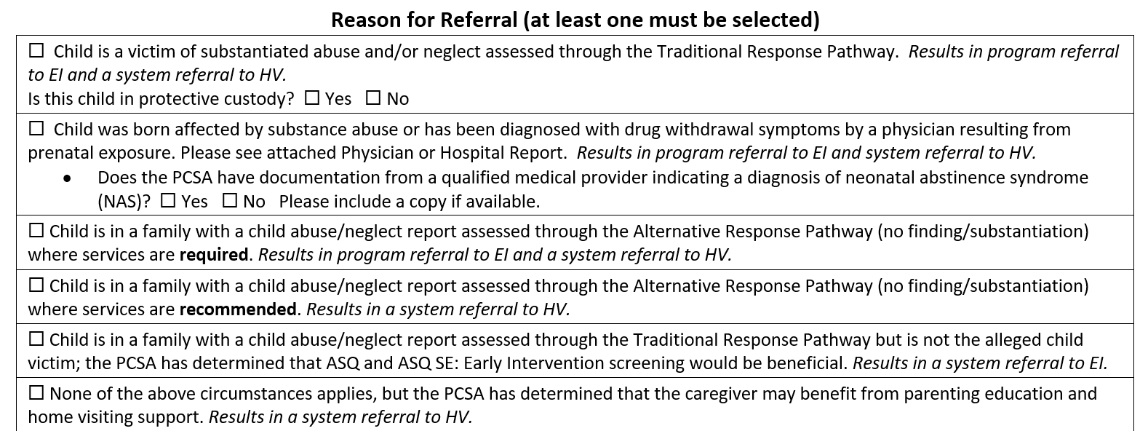
Key: System referral = incoming referral
Program referral = assignment to provider
REFERRAL FORM HEA8021
Notes:
Referring a child to Help Me Grow involves using the HEA8021 form. There is a web referral form used by other referral sources but please keep in mind that PCSA is not permitted to use that method for referring.
Each box checked on the referral form requires a different action for HMG CIR:
If the first, second or third box is checked, there is an automatic program referral to EI (also known as an automatic assignment to the EI provider), and a system or incoming referral to HV which requires HMG CIR to reach out to the caregiver to explore the need and interest in HV services.
The fourth box is a system referral to HV recommending HV only so HMG CIR would contact the caregiver about HV (unless a developmental delay is noted and then we would offer both services).
The fifth box is a system referral to EI recommending EI services so HMG CIR would contact the caregiver to offer EI services.
Finally the last box allows PCSAs to suggest HV for a family if none of the other options apply. This choice is new and will hopefully allow use of this form regardless of the family’s situation.
We briefly mentioned a few examples of when to refer for pregnant women and want to clarify how to use the form to refer:
For pregnant women with other children involved in a traditional/alternative response pathway include the due date on the form in the “Other information that would be helpful in planning services for the child/caregiver:” field.
For teens in custody who are pregnant. Please use the PDF version of the PCSA form as SACWIS will not provide the PCSA form as an option to complete and check the last box (#6) in the Reason for Referral section: “None of the above circumstances applies, but the PCSA has determined that the caregiver may benefit from parenting education and home visiting support. Results in a system referral to HV.” Include the teen’s due date in the “Other information that would be helpful in planning services for the child/caregiver” field. In this case, there will not be a child list on the first page of the form. The pregnant teen’s information will be placed under the biological parent section.

Slide 15
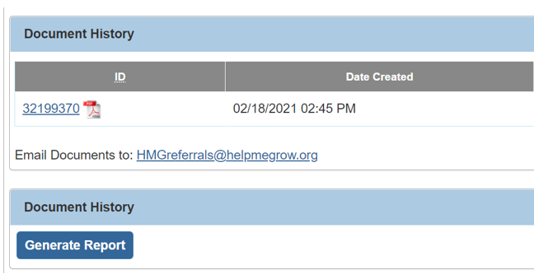
SUBMITTING A REFERRAL
Use the HEA8021 form in SACWIS ensuring all information is up to date and complete.
Click the link to email the HEA8021 form to:
hmgreferrals@helpmegrow.org
If using the PDF form for a pregnant teen in custody, email the HEA8021 form to hmgreferrals@helpmegrow.org
Notes:
Referring a child to Help Me Grow involves using the HEA8021 form as we just described. In order to submit the referral, please email it to hmgreferrals@helpmegrow.org whether it is the form generated by SACWIS or the PDF version for a pregnant teen in custody.
Although you and your team may hear about the HMG web referral form on our website, rule requires PCSA staff to utilize this specific HEA8021 form.
Please ensure all information is update to date and complete when submitting the form including your contact information, the child’s caregiver and the biological caregiver information so we can communicate with the appropriate parties effectively.

Slide 16
PROCESSING REFERRALS
STEP 1
System referral received
STEP 2
Contact family to determine interest (depending on Reason for Referral chosen)
STEP 3
Program determination
STEP 4
Complete program referral/exit
STEP 5
Referral Follow-up
Notes:
Once a referral is received by Central Intake, the central intake staff reach out to the family.
There are five basic steps when a referral is made to Central Intake.
1.) Upon receipt of the referral, the referral is entered into the appropriate data system.
2.) For those referrals with boxes #1 – 3 checked indicating a program referral to EI, these children/families will be automatically assigned to an EI provider.
3.) If a box is checked indicating a system/incoming referral to EI and/or HV, CIR will make contact out to the family within one business day of receipt. A minimum of three attempts to contact the family are made by phone, texting, email, and/or mail depending on availability within 14 calendar days. We know that many parents, especially new mothers and fathers, are unavailable when intake calls and can benefit from multiple attempts at different times during the day and/or week.
3a.) If contact with the family is made, services are explained, a risk assessment is completed (as applicable for home visiting), and program options are provided based on eligibility and availability.
The program referral or assignment to the provider is made in the data system upon acceptance of the services by the family.
3b.) If contact is not made with the family or they decline, Central Intake exits the referral in the data system and informs the referral source.
4.) You will receive follow-up for your referral if:
4a.) Central intake is unable to reach the family;
4b.) The family declines services; or
4c.) The family consents to share that they are enrolled in services

Slide 17
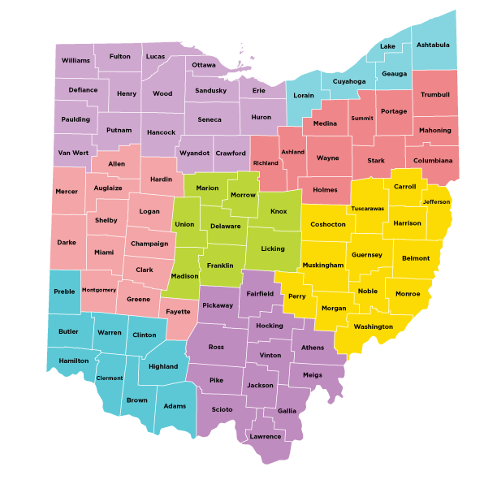
LEARN MORE
Visit helpmegrow.org to:
Learn more about Early Intervention or Home Visiting
Find family-friendly information about each program
Use our Community Resource Directory
Find contacts for each region of the state
Notes:
Today’s webinar will cover a lot of information about the Help Me Grow system of support and its two programs: Early Intervention and Home Visiting. We encourage you to visit our website to learn more about these services, obtain family-friendly information to share with families about each program, access our statewide Community Resource Directory, and contact any of the eight regional centers for HMG Central Intake as questions arise about services and/or referring.

Slide 18
Notes:
We would like to take this opportunity to answer any questions you may have at this time.

Slide 19
Help Me Grow Home Visiting
Liz Lococo-Clouston
Elizabeth.Lococo@odh.ohio.gov

Slide 20
What is Home Visiting?
Home Visiting is an in-person, evidence-based program that provides pregnant women and families, particularly those considered at-risk, necessary resources and skills to raise children who are physically, socially, and emotionally healthy and ready to learn. (OAC 3701-8)
Notes:
Good morning, everyone. I am Nikki Montgomery, Senior Community Liaison at Bright Beginnings. With me is Melissa Bixel, Contract Manager for the Statewide Central Intake and Referral System.
Thank you for giving us the opportunity to share information about the Early Childhood Central Intake and Referral model currently provided by Bright Beginnings for Early Intervention and Home Visiting across Ohio. At Bright Beginnings, we are passionate about getting families connected to services that support a healthy life.
Bright Beginnings was awarded the statewide contract through the Ohio Department of Health in July 2018. Since that time, we have developed a system that is flexible to meet the needs of the state departments, service providers, and families.

Slide 21
WHO CAN BE REFERRED TO HOME VISITING?
Pregnant women
New mom or dad
Caregiver to eligible child
Prenatal up to age 2**
Services are income-based
**Depending on provider availability in the county.

Slide 22
Models

Slide 23
Current Eligibility
 | Prenatal under 28 weeks | Prenatal 29 weeks to delivery | Up to 3 months | Up to 6 months | 6 -24 months | Model Specific Notes
 |  |  |  |  |  | Only first-time moms; except in Dayton where pilot is occurring
 |  |  |  |  |  | 15% of families can have baby older than 3 months (alternate)
 |  |  |  |  |  | Model allows for enrollment through 24 months; Ohio rules limits
 |  |  |  |  |  | Enrollment during pregnancy only
Notes:
In 2019, Governor DeWine conveyed a group of key stakeholders to serve on a Home Visiting Advisory Committee. The committee created a list of 20 recommendations to strengthen the HV system. One of the barriers identified by that group was the ability to serve families referred by, or involved in, the child welfare system because the child was too old at the time of referral to be eligible for the family to receive services. To address this issue, we have been working closely with the national models we implement and are excited to share that we are getting ready to implement expanded eligibility for families referred by child welfare in two of our models. To begin with, we wanted to share current eligibility requirements.

Slide 24
Expanded Eligibility
 | Prenatal under 28 weeks | Prenatal 29 weeks to delivery | Up to 3 months | Up to 6 months | 6 -24 months | Model Specific Notes
 |  |  |  |  |  | If provider agrees to participate, all moms
 |  |  |  |  |  | If a provider applies for the CWP, families referred by children’s services up to 24 months
 |  |  |  |  |  | Model allows for enrollment through 24 months; Ohio rules limit to 6 months; families referred by children’s services up to 24 months
 |  |  |  |  |  | No changes are proposed to this model; Enrollment during pregnancy only
Notes:
We are currently in the process of our reviewing our HV rules to allow for expanded eligibility in three out of four of our current models.
Go through the explanation here.
In all three of the models eligible for expansion, we want to make sure people are aware that it is up to the individual program if they want to participate in the expanded models. For both PAT and HFA, programs will need to complete an application and implementation plan as part of an approval process through the Department of Health. With the implementation plan, they will be required to complete an MOU with their local child welfare agency, outlining the role and responsibilities of each agency in working with families and collaborating with each other. HFA programs will then need to submit an application with the national HFA office for approval. After that, programs will be able to begin implementing the expanded eligibility protocols. We are also working closely with JFS to develop training in order to support HV staff in working with families referred by, or involved with child welfare, realizing these families may need supports that are unique to the situations resulting in their referral.

Slide 25
Home Visiting Supports
Home Visiting raises the standards of care for Ohio’s families and their children by providing services are designed to help women achieve healthy pregnancies and births; ensure young children are healthy, developing to their full potential, and ready to start school; strengthen parenting practices and reduce child maltreatment; and support family self-sufficiency.
This is done by:
Ensure families are supported and served by trained, respectful, and culturally sensitive home visitors or community health workers.
Offer voluntary, confidential services in everyday environments for the family based on their needs.
Focus on improving health care and access for mothers, children and family members.
Conduct various and on-going assessments and screenings for caregivers and children.
Monitor interactions and environment for child safety and risks for child abuse and neglect.
Promote child development and school readiness using evidence-based curriculums.
Provide families with linkages and referrals to needed, beneficial community supports.
Assist in transitioning children and family to an educational setting or community programs.

Slide 26
Home Visitor Responsibilities
Conduct health, developmental, environmental, and relationships screenings
Deliver education and information about early childhood growth and development and positive parenting practices
Facilitate enjoyable parent-child interactions
Support parent-driven, family orientated, and self-sufficiency building goals plans
Collaborate with the social service coordinators also working with the families (e.g., Early Intervention Service Coordinators, JFS caseworkers)
Acknowledge and celebrate child and family successes
Assist with transition planning for the children and family to the appropriate settings

Slide 27
Positive Outcomes
Maternal Health
Child Health
School Readiness
Improvement in Economic Self-Sufficiency
Reduction in Juvenile Delinquiency, Family Violence and Crime
Increase in Linkages and Referrals

Slide 28
Thank You

Slide 29
Help Me Grow Overview for Public Children Services Agencies
March 10, 2021
Nathan DeDino, Part C Coordinator Diane Fox, Early Intervention Program Manager
Notes:
Welcome/Introductions

Slide 30
What is Early Intervention?
Notes:
Early Intervention (EI) is a statewide system that provides coordinated early intervention services to parents of eligible children under the age of three with developmental delays or disabilities. The Ohio Department of Developmental Disabilities (DODD) serves as the state’s lead agency for Ohio Part C Early Intervention program under the Individuals with Disabilities Education Act (IDEA). EI is grounded in the philosophy that young children learn best from familiar people in familiar settings. Every family served in EI will have a local EI team that consists of a service coordinator, service providers, and the family. The team works with families in their home or other places the family spend time to develop a coordinated plan called an Individualized Family Service Plan (IFSP). The team will work through your IFSP plan to use the family's existing supports and resources—and build upon them—to learn to enhance children's learning and development.

Slide 31
Who is eligible for Early Intervention?
Notes:
To be eligible for Early Intervention, a child must be under the age of three and have either a diagnosis with a high probability of resulting in a developmental delay/disability (e.g., NAS, Down Syndrome, Autism ) or demonstrate a developmental delay of 1.5 SD in one or more developmental domains using a standardized tool..

Slide 32
Referral
Notes:
Any agency or person can refer a potentially eligible child to Early Intervention. Generally, if someone other than a parent makes the referral, central intake will reach out to the parent to determine if the parent wants to move forward with the EI program referral. However, under IDEA, certain referrals from the PCSA must move forward to an EI program referral, so central intake will not reach out to the parent before assigning the referral to the local EI program. If the substantiated abuse and neglect, substance abuse/withdrawal, or Alternative Response Pathway where services are required boxes are checked on the PCSA form, central intake will enter information from the form in the EI data system and assign the referral to the appropriate local EI program. If other boxes are checked, central intake will first reach out to the family to determine interest in EI.

Slide 33
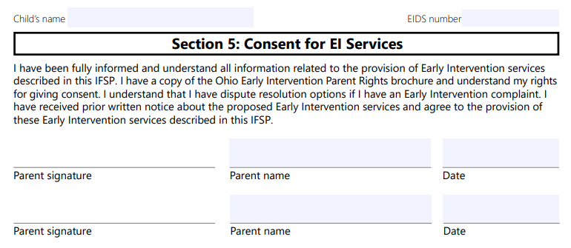
Is EI voluntary?
Notes:
EI is a voluntary program. Even though PCSAs must make certain referrals to EI, local EI programs can only move forward with the EI process with parent consent under IDEA. EI can never require a family to consent to an evaluation or to receive services.
(Also, parents can say yes to some services and no to others-or is this too confusing?)

Slide 34
What happens after a referral is made?
Service Coordinator assigned
Eligibility and
Assessment
Individualized Family Service Plan (IFSP)
Service Delivery
Transition
Notes:
After a referral is made to the local EI program, the family will be assigned an EI service coordinator. The EI service coordinator is responsible for coordinating the family’s EI journey. The EISC will coordinate the eligibility and assessment process. If the child is eligible, the EISC will coordinate a CORE team of early interventionists to develop an Individualized Family Service Plan, or IFSP. The first step is to determine if the child is eligible for EI. If the child is not suspected of having a developmental delay or disability, the family may be offered a developmental screening rather than an evaluation. If the child has a qualifying diagnosis, the EISC will obtain documentation of that diagnosis to substantiate eligibility for EI. If there is no diagnosis, the EISC will coordinate a developmental evaluation to determine if the child is eligible. The developmental evaluation looks at five developmental domains and must be completed by an evaluator or evaluators representing at least two disciplines.

Slide 35
The Individualized Family Service Plan
Notes:
Prior to moving on to creating the IFSP, the EISC will coordinate an assessment of the child and, with parent consent, a family assessment. The information from the assessments are important in determining the priorities and outcomes the family wants to work on. These outcomes are documented on the IFSP. The IFSP team of potential EI service providers then uses the outcomes to determine which EI service(s)—and at what frequency—are necessary to meet the outcomes. From the time of the referral to the IFSP, all activities must be completed within 45 days under IDEA. Any service on an IFSP must begin with 30 days of being added to an IFSP.

Slide 36
Transition Plan
Nine months – 90 days before 3rd birthday
EI Service Coordinator
plan documented on IFSP
school district notified with parent consent
Transition planning conference
Notes:
As a child approaches their third birthday, the EISC must coordinate different activities to ensure a smooth transition when the child leaves EI. Not more than nine months, but at least 90 days, before a child’s third birthday, all children will have a transition plan documented in their IFSP. With parent consent, the EISC will also notify the child’s school district that the child is potentially eligible for Part B special education services and is approaching their third birthday. The EISC will also coordinate a transition planning conference meeting that may include the child’s school district.

Slide 37
Exit
Notes:
EI ends on a child’s third birthday. Regardless of whether a child will be served in special education preschool, in a private preschool, at home, or anywhere else, the entire EI team will work to ensure a smooth transition at age three.

Slide 38
Thank you

Slide 39
The Comprehensive Addiction and Recovery Act 2016 (CARA)
Deanna Herold, MS
Deanna.Herold@jfs.ohio.gov

Slide 40
CARA’s Impact
Three Primary Systems
Hospitals – specifically OBGYN, Labor and Delivery
Community Providers
Substance abuse treatment agencies
Mental Health
Medical (primary pediatricians, etc.)
Early Intervention/Help Me Grow
Child Welfare Agencies
Goal: System to work collaboratively to ensure the requirements of CARA are met and families are supported.
Child Welfare
Community Partners
Medical
Partners

Slide 41
What is a Plan of Safe Care?
Federally required – signed into law on July 22, 2016
Describes the services and supports needed to comprehensively address the needs of infants prenatally exposed to the misuse of substances (both legal and illegal) and their families.
Identification of ALL family members and caregivers health care needs
Substance use disorder treatment services
Developmental intervention for the baby
Services and supports needed to promote family stability
Incorporates all treatment plans developed by the multidisciplinary professionals serving the family.
Developed with the parents and service providers
May or may not require involvement of child welfare agencies

Slide 42
CAPTA
CARA amended the Child Abuse Prevention and Treatment Act (CAPTA).
Requires a plan of safe care to be in place at the time of discharge from the hospital for the following:
Infants 12 months and younger if:
Prenatally exposed to the misuse of substances
Demonstrating symptoms of withdrawal
Diagnosed with Fetal Alcohol Spectrum (FAS)
In addition, CAPTA requires child welfare agencies to document the existence of the Plan of Safe Care.
Community Concern:
CAPTA requires child welfare agencies to document the existence or lack of existence of the Plan of Safe Care. This does not necessarily mean child welfare remains involved past the referral point, as families with an adequate Plan of Safe Care will be screened out, with no services provided by child welfare. Monitoring of the Plan of Safe Care becomes the service providers responsibility.

Slide 43
CARA’s Impact on Child Welfare
The state is required to apply policies and procedures to address infants affected by all substance abuse – not just illegal as was the requirement prior to the change.
The rules have been updated to include CARA requirements – Ohio Administrative Code 5101:2-36 Screening and Investigation

Slide 44
CARA’s Impact on Child Welfare
Additional Requirements are to:
Ensure the safety and well-being upon release from the care of health care providers (hospitals, clinics, maternal wards, etc.)
Address the health and substance use disorder treatment needs of the infant and affected family and caregiver.
Monitor plans to determine whether and how local entities are making referrals and delivering appropriate services to the infant and the family or caregiver.
Develop the Plan of Safe Care for any infant affected by all substance abuse (illegal and legal).

Slide 45
CARA’s Impact on Child Welfare
Requires the following data to be reported to the National Child Abuse and Neglect Data System (NCANDS):
The number of infants identified as being affected by substance aabuse, withdrawl systemps resulting from prenatal drug exposure or Fetal Alcohol Spectrum Discorder.
The number of infants for whom a Plan of Safe Care was developed.
The number of infants for whom referrals were made for appropriate services – including services for the affected family or caregiver.

Slide 46
CARA’s Impact on Child Welfare
Further clarified the population requiring a plan of Safe Care
“infants born with and identified as being affected by substance abuse or withdrawal symptoms resulting from prenatal drug explosure, or a Fetal Alcohol Spectrum Disorder”. The word “illegal” was intentially removed this this sentence – CARA addresses both the legal and illegal abuse of substances.

Slide 47
Expectations of Mandated Reporters
The requirements for mandated reporters have not changed – per OAC and ORC, all mandated reporters shall make a referral to PCSA when an infant is impacted by the abuse of legal or illegal substances when:
Infant is exhibiting symptons of withdrawal;
Mother missed legal or illegal substances during pregnancy;
Infant has a positive toxology result; or
Infant is diagnosed with Fetal Alcohol Syndrome
CPS is the decision maker – if the above is known, reported or observed – it is expected that a referral will be made to the county child welfare agency.
Large percentage of referrals will ceom from hospitals at time of delivery.

Slide 48
Mandated Reporter Action Steps
Responsibilities of community providers making referrals:
Any known medical information on infant, parents and/or caregivers of the identified infant
Concerns regarding follow through on the needs of the infant, parent, or any caregiver residing in the home of the infant
Treatment plan and information regarding participating, progress, and/or lack of follow through
Health and substance use history of mother, father and caregiver(s) residing in the home where the identified infant is residing (diagnosis, prescribed medications, substance use treatment plans and contact information for all service providers)
Communication and collaboration between all community providers working with the family

Slide 49
Screening Expectations
CPS agencies are required to collect the following information on all referrals:
Ensure a Plan of Safe Care has been established
Ensure the Plan of Safe Care addresses the safety needs of the infant
Ensure the Plan of Safe Care addresses the health and substance use disorder treatment needs of the affected family or caregiver(s)
Note: The referral will be screened out by child welfare if an adequate Plan of Safe Care is in place fo the infant, family and any caregivers resding in the home. Monitoring of the plan of Safe Care will then be the responsibility of the community providers working with the family.

Slide 50
Thank you!

Slide 51
Creating a Help Me Grow Referral
Statewide Automated Child Welfare Information System
(SACWIS)
Michele Lidle
Michele.Lidle@jfs.ohio.gov

Slide 52
Referral Updates in SACWIS
New questions to complete the form
Plan of Safe Care
Neonatal Abstinence Syndrome
Visitation arrangements
Judicial orders
Additional information about parents and primary caregiver
Updated screens and form available March 2021

Slide 53
Referral Updates in SACWIS
Referral link is accessed from the Help Me Grow Case Service

Slide 54
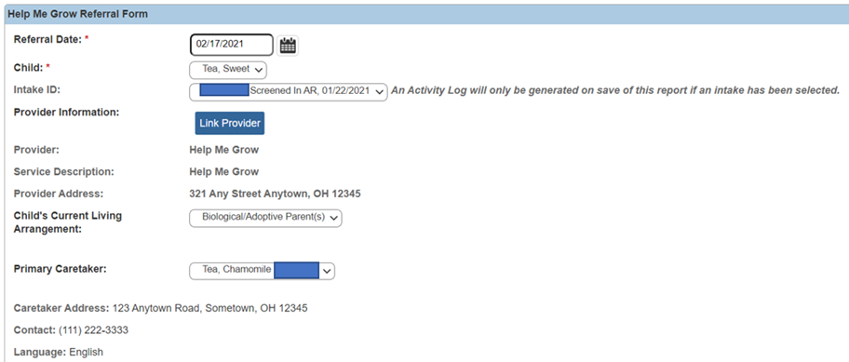
Referral Updates in SACWIS

Slide 55
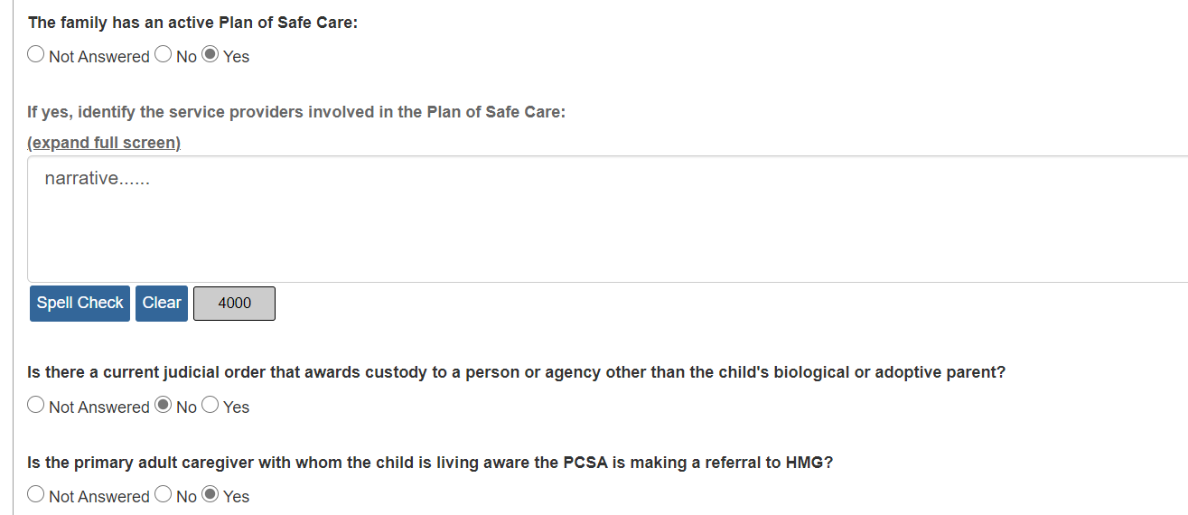
Referral Updates in SACWIS

Slide 56
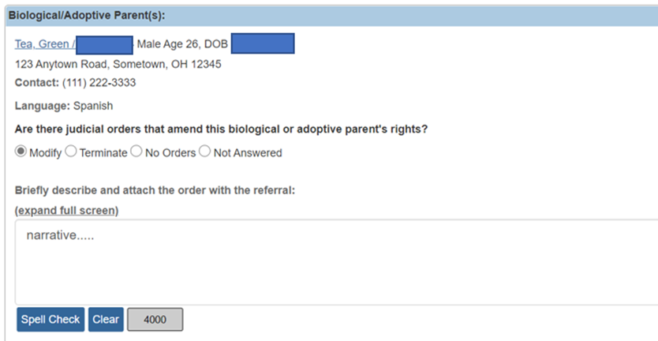
Referral Updates in SACWIS

Slide 57
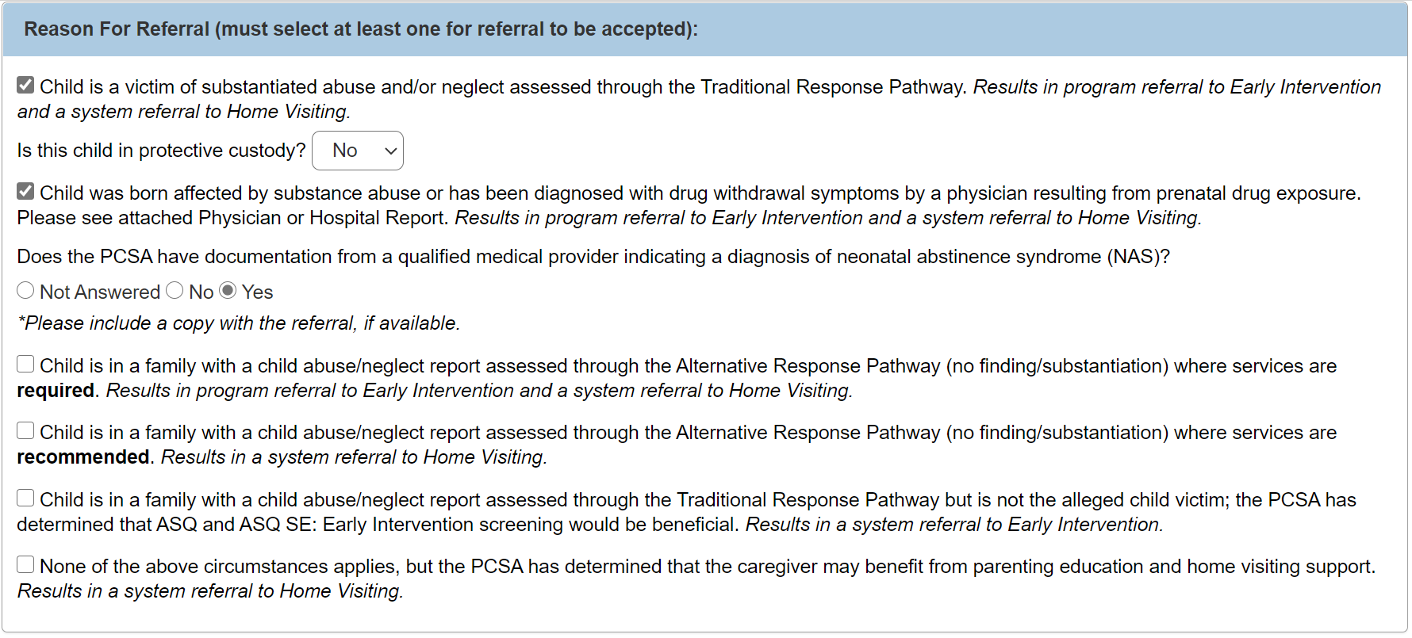
Referral Updates in SACWIS

Slide 58
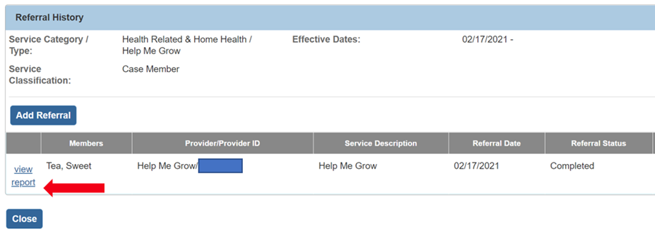
Referral Updates in SACWIS
Referral is marked as Completed and Saved:
System updates the Case Service status to Referred
The Referral Form report can be generated

Slide 59
Referral Updates in SACWIS
Report is saved as a PDF
Download and send to central intake via the email link displayed on the screen.

Slide 60
Referral Updates in SACWIS
More information and a step-by-step guide can be found on the SACWIS Knowledge Base:
Creating a Help Me Grow Referral from Case Services

Slide 61
Key Takeaways
It is a requirement for each agency to incorporate multidisciplinary professionals serving the family.
To ensure families are connected to services quickly, it is important for case workers to be responsive to requests for additional information from Central Intake and Referral.
With parent consent, home visitors and service coordinators should be in regular communication and on-going planning with the family’s caseworker.
By working together collaboratively, case workers, home visitors and early intervention service coordinators can build an effective system of supports for families.

Slide 62
Thank you!

